Slide 1
CC3011 - Operating Systems
Ayesha Asmat
ayesha.asmat@umt.edu.pk

Slide 2
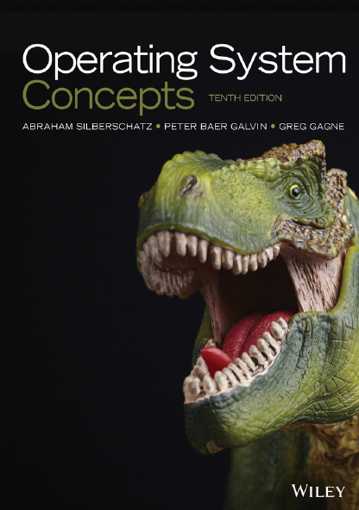
Text Book
Operating Systems Concepts, 10th edition, Abraham Silberschatz, Peter Baer Galvin, Greg Gagne; Wiley.

Slide 3
Grading Scheme (tentative)
Total | 100 marks
Assignment, Quizzes, CCP& Presentation | 30-35 marks
Mid term | 25-30 marks
Final term | 40 marks

Slide 4
Topics
Introduction to Operating-System
Operating-System Structures
Processes
Threads and Concurrency
CPU scheduling
Synchronization Tools
Deadlocks
Main Memory
Virtual Memory
File System

Slide 5
What Does the Term Operating System Mean?

Slide 6
What is Operating system
A program that acts as an intermediary between a user of a computer and the computer hardware
Operating system goals:
Execute user programs and make solving user problems easier
Make the computer system convenient to use
Use the computer hardware in an efficient manner
User
OS
Hardware

Slide 7
What is Operating system
An operating system (OS) is:
A software acts as an intermediary between the user of a computer and the computer hardware.
The purpose of an operating system is to provide an environment in which a user can execute programs in a convenient and efficient manner.

Slide 8
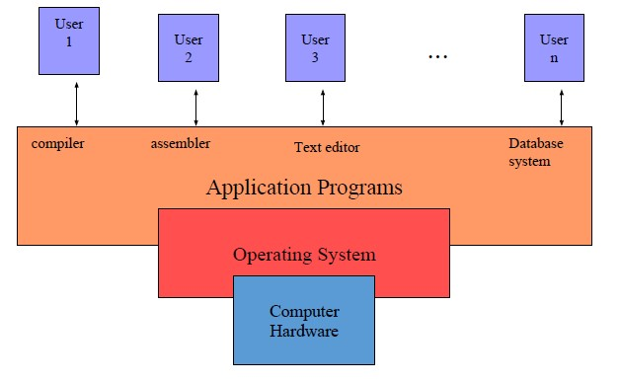
Computer System Structure
A computer system can be divided roughly into four components: the hardware, the operating system, the application programs, and a user

Slide 9
Computer System Structure
Computer system can be divided into four components:
Hardware – provides basic computing resources
CPU, memory, I/O devices
Operating system
Controls and coordinates use of hardware among various applications and users
Application programs – define the ways in which the system resources are used to solve the computing problems of the users
Word processors, compilers, web browsers, database systems, video games
Users
People, machines, other computers

Slide 10
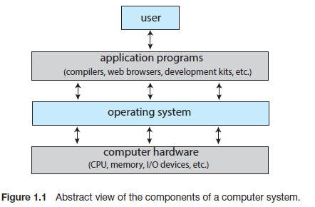
What Operating Systems Do
User View
System View

Slide 11
User View
The user’s view of the computer varies according to the interface being used.
General Purpose PC
Users want convenience, ease of use and good performance
Don’t care about resource utilization

Slide 12
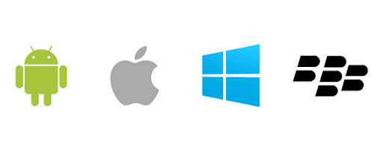
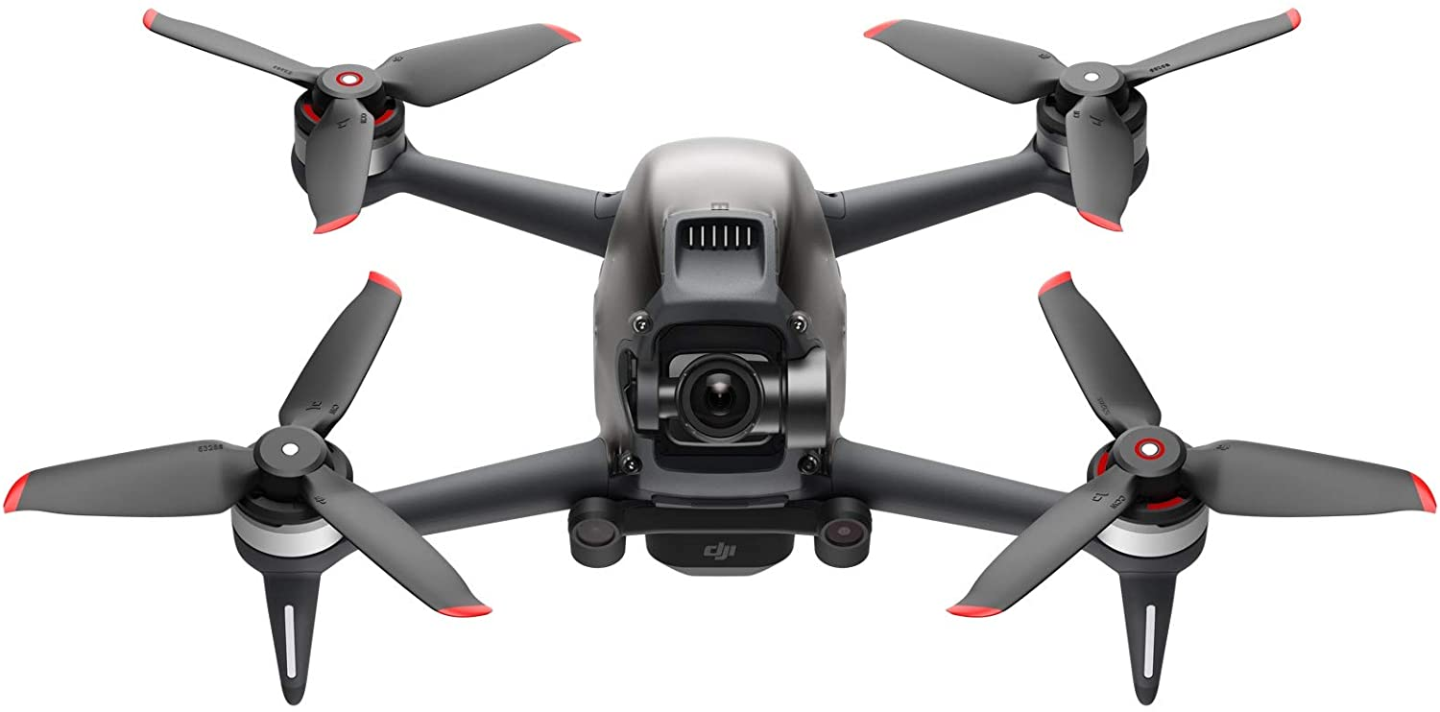
User View
Mobile devices like smartphones and tables OS helps devices to run applications and programs.
A mobile OS typically starts up when a device powers on, presenting a screen with icons or tiles that present information and provide application access.
Embedded OS in devices and automobiles

Slide 13
Defining Operating Systems
Term OS covers many roles
Present in toasters, Oven, smart home appliances, ships, spacecraft, game machines, TVs and industrial control systems
Special Purpose for military, automobile industry, Etc.

Slide 14
System View
From the computer’s point of view, the operating system is the program involved with the hardware.
OS is a resource allocator
Manages all resources
Decides between conflicting requests for efficient and fair resource use
OS is a control program
Controls execution of programs to prevent errors and improper use of the computer

Slide 15
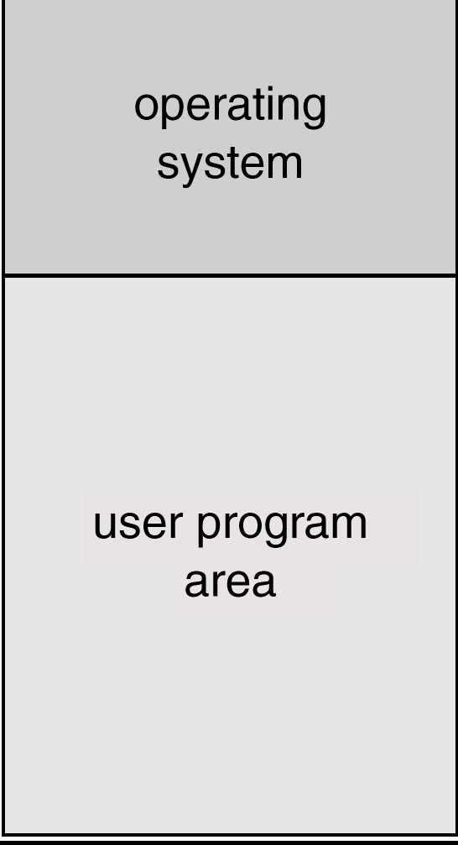
Operating System
Core Part of OS
“The one program running at all times on the computer” is the kernel, part of the operating system
Two types of software/program
A system program or
An application program, all programs not associated with the operating system

Slide 16
Computer Startup
bootstrap program is loaded at power-up or reboot
Typically stored in ROM or EPROM, generally known as firmware
Initializes all aspects of system
Loads operating system kernel and starts execution

Slide 17
Overview of Computer System Structure

Slide 18
Computer System Organization
Computer-system operation
One or more CPUs, device controllers connect through common bus providing access to shared memory
Concurrent execution of CPUs and devices competing for memory cycles

Slide 19
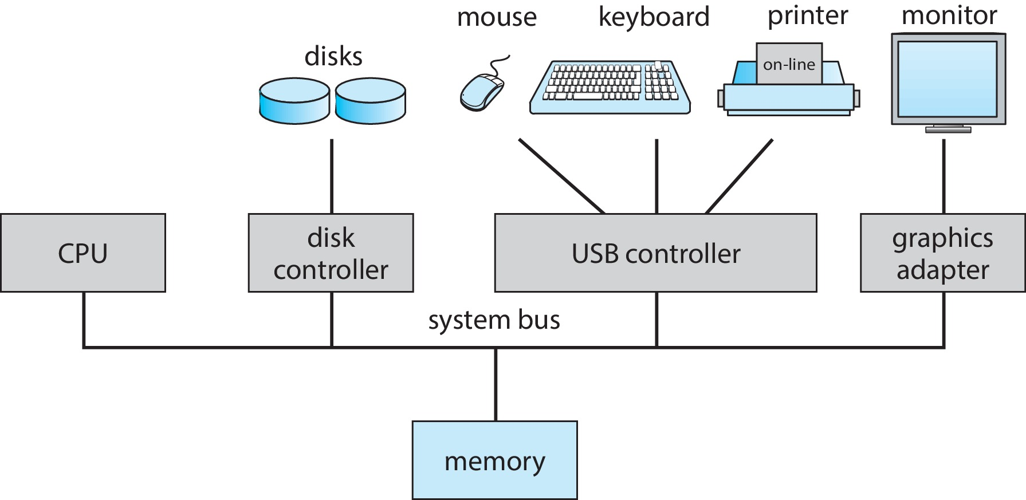
Computer System Organization

Slide 20
Computer-System Operation
I/O devices and the CPU can execute concurrently
Each device controller is in charge of a particular device type
Each device controller has a local buffer
Each device controller type has an operating system device driver to manage it
CPU moves data from/to main memory to/from local buffers
I/O is from the device to local buffer of controller
Device controller informs CPU that it has finished its operation by causing an interrupt

Slide 21
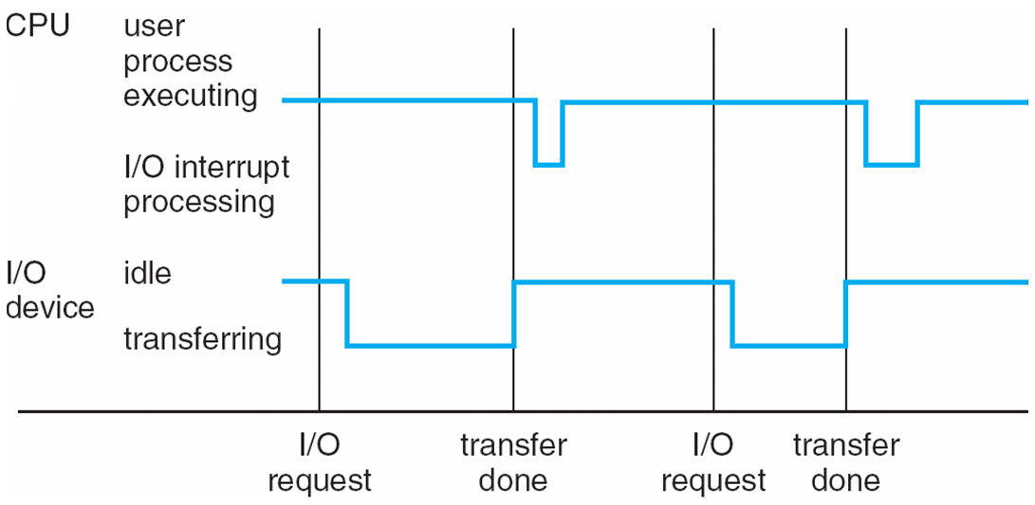
Interrupt Timeline

Slide 22
Common Functions of Interrupts
Interrupt transfers control to the interrupt service routine generally, through the interrupt vector, which contains the addresses of all the service routines
Interrupt architecture must save the address of the interrupted instruction
A trap or exception is a software-generated interrupt caused either by an error or a user request
An operating system is interrupt driven

Slide 23
Computer-System Operation
Device controller informs CPU that it has finished its operation by causing an interrupt
The trap is a signal raised by a user program instructing the operating system to perform some functionality immediately. In contrast, the interrupt is a signal to the CPU emitted by hardware that indicates an event that requires immediate attention.
A trap is generated by a user program instruction. In contrast, the hardware devices generate an interrupt.
A trap is also known as a software interrupt. In contrast, an interrupt is known as a hardware interrupt

Slide 24
Interrupt-drive I/O Cycle

Slide 25
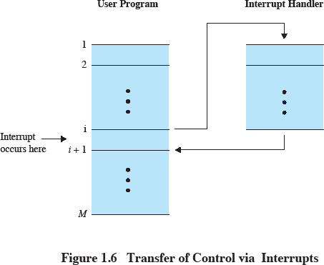
Transfer of Control via Interrupts

Slide 26
I/O operations
In Programmed I/O the CPU is involved in a constant loop & constant status checking. CPU cannot do any thing else. However the I/O transfer speed is quite fast
In Interrupt driven I/O some other functions are being done by the CPU & I/O interpretation takes place only when an interrupt is initiated. However in the entire duration of data transfer active participation of CPU is involved
This brings us to a third transfer mode and that is Direct Memory Access (DMA)
29

Slide 27
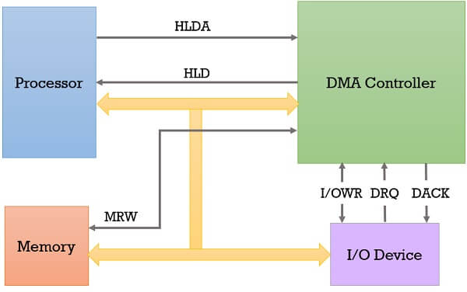
Direct Memory Access (DMA)
Direct memory access (DMA) is a method that allows an input/output (I/O) device to send or receive data directly to or from the main memory, bypassing the CPU to speed up memory operations.
30

Slide 28
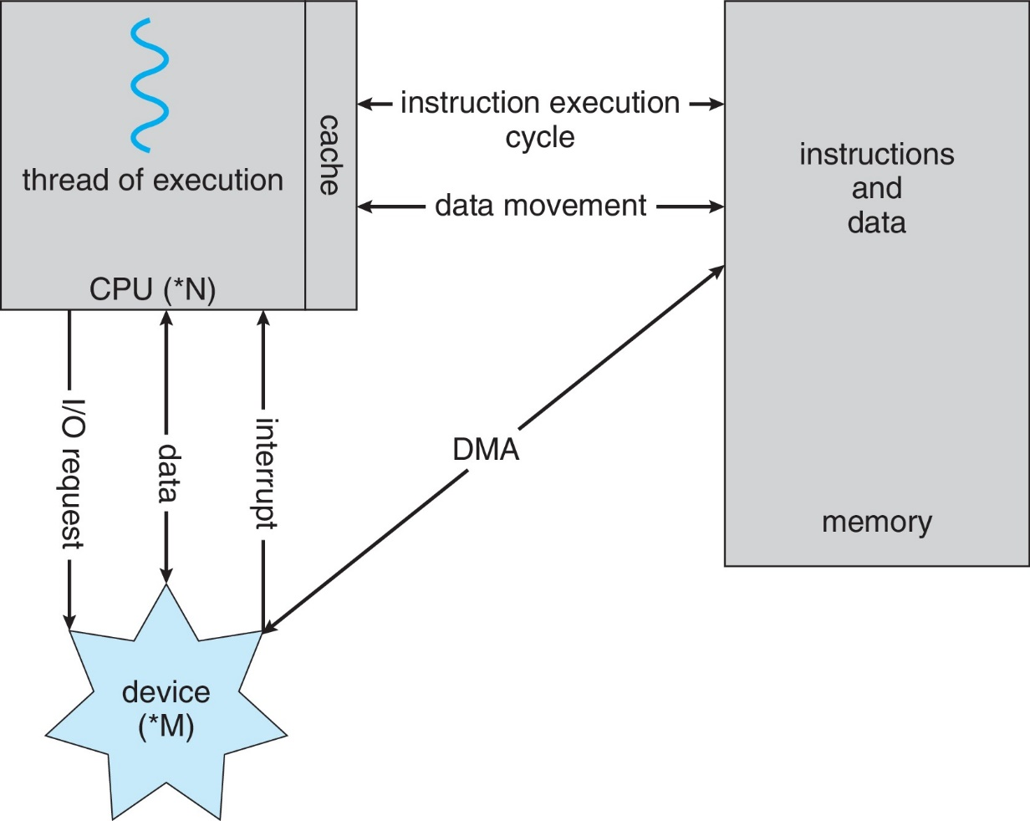
How a Modern Computer Works
A von Neumann architecture

Slide 29
Storage Structure

Slide 30
Storage Structure
Main memory – only large storage media that the CPU can access directly
Random access
Typically volatile
Typically random-access memory in the form of Dynamic Random-access Memory (DRAM)
Secondary storage – extension of main memory that provides large nonvolatile storage capacity

Slide 31
Storage Structure (Cont.)
Hard Disk Drives (HDD) – rigid metal or glass platters covered with magnetic recording material
Disk surface is logically divided into tracks, which are subdivided into sectors
The disk controller determines the logical interaction between the device and the computer
Non-volatile memory (NVM) devices– faster than hard disks, nonvolatile
Various technologies
Becoming more popular as capacity and performance increases, price drops

Slide 32
Memory Hierarchy
Major constraints in memory
Amount
Speed
Expense
Faster access time, greater cost per bit
Greater capacity, smaller cost per bit
Greater capacity, slower access speed

Slide 33
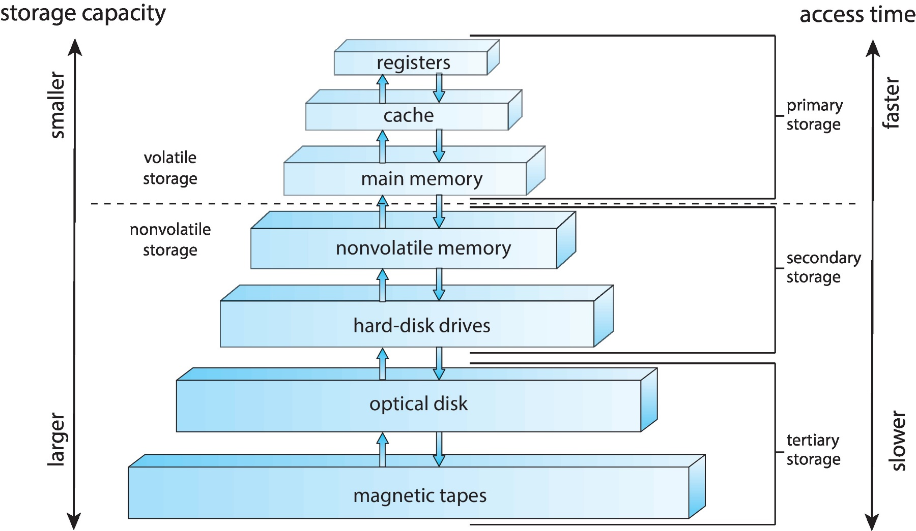
Storage-Device Hierarchy

Slide 34
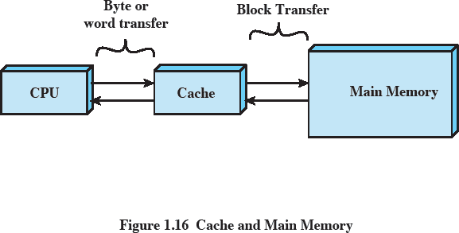
Cache and Main Memory
Caches Contains copy of a portion of main memory
Processor first checks cache
– If not found, block of memory read into cache
Because of locality of reference, likely future memory references are in that block

Slide 35
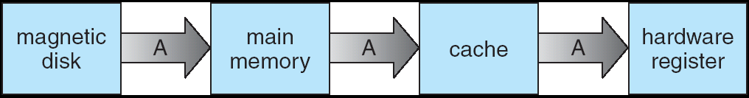
Migration of Data
from Disk to Register

Slide 36
Computer-System Architecture

Slide 37
Computer-System Architecture
Modern computers use multi-core general-purpose CPUs instead of single-core ones.
They also include special-purpose processors like GPUs and controllers for specific tasks.
Multi-core and multiprocessor architectures have become standard, especially in servers, cloud systems, and high-performance computers, due to their speed, efficiency, and scalability.
Multiprocessors systems Two types:
Asymmetric Multiprocessing – each processor is assigned a specie task.
Symmetric Multiprocessing – each processor performs all tasks

Slide 38
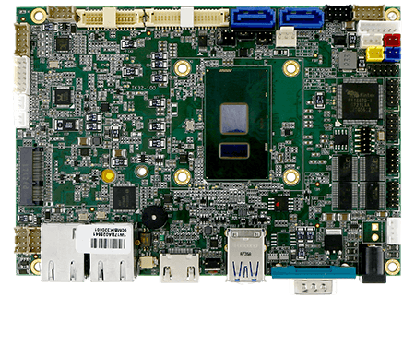
Single Processor Systems

Slide 39
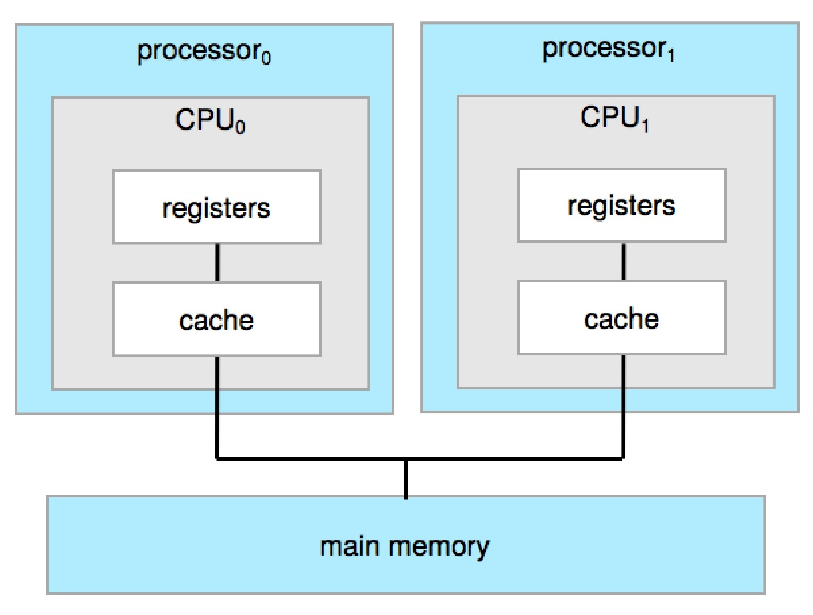
Symmetric Multiprocessing Architecture

Slide 40
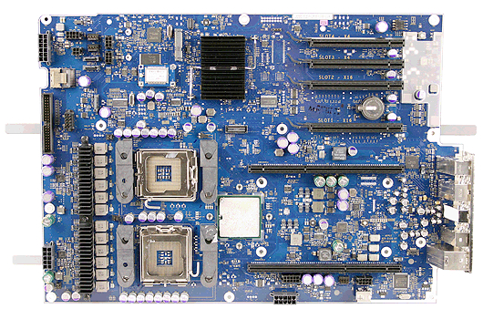
Multiprocessor Systems

Slide 41
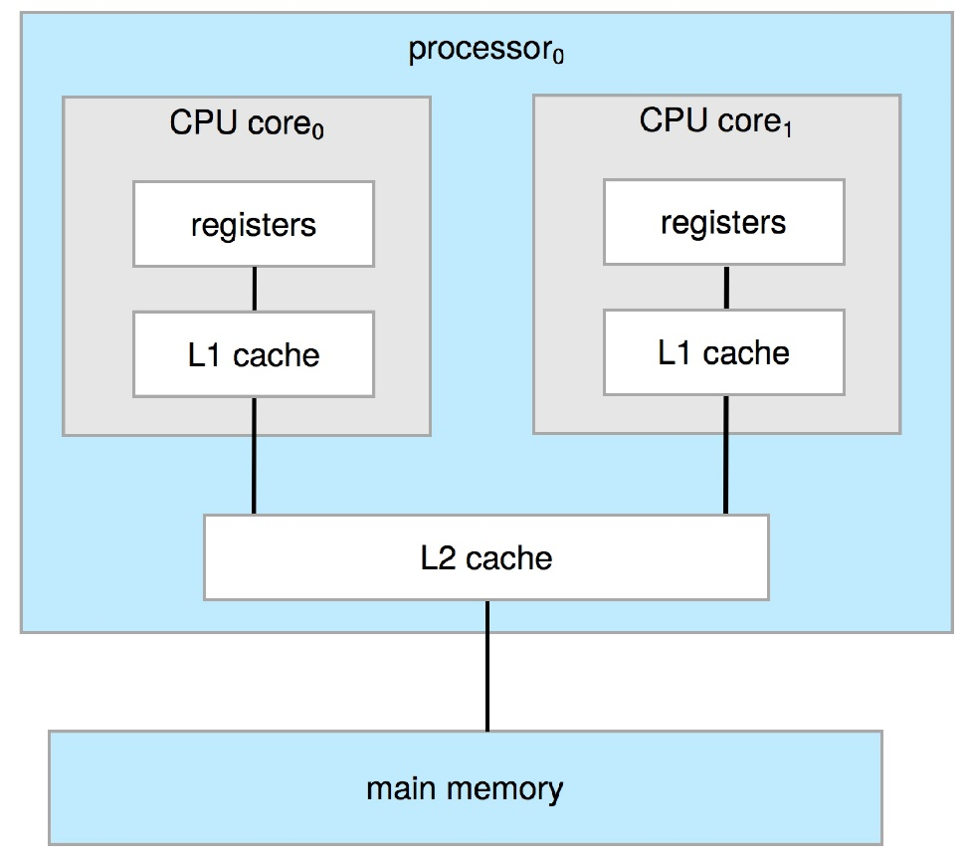
Dual-Core Design
The definition of multiprocessor has evolved over time and now includes multicore systems, in which multiple computing cores reside on a single chip.
Multicore systems can be more efficient than multiple chips with single cores

Slide 42
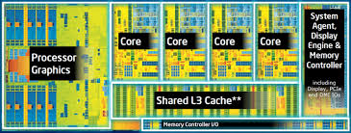
Multicore Systems

Slide 43
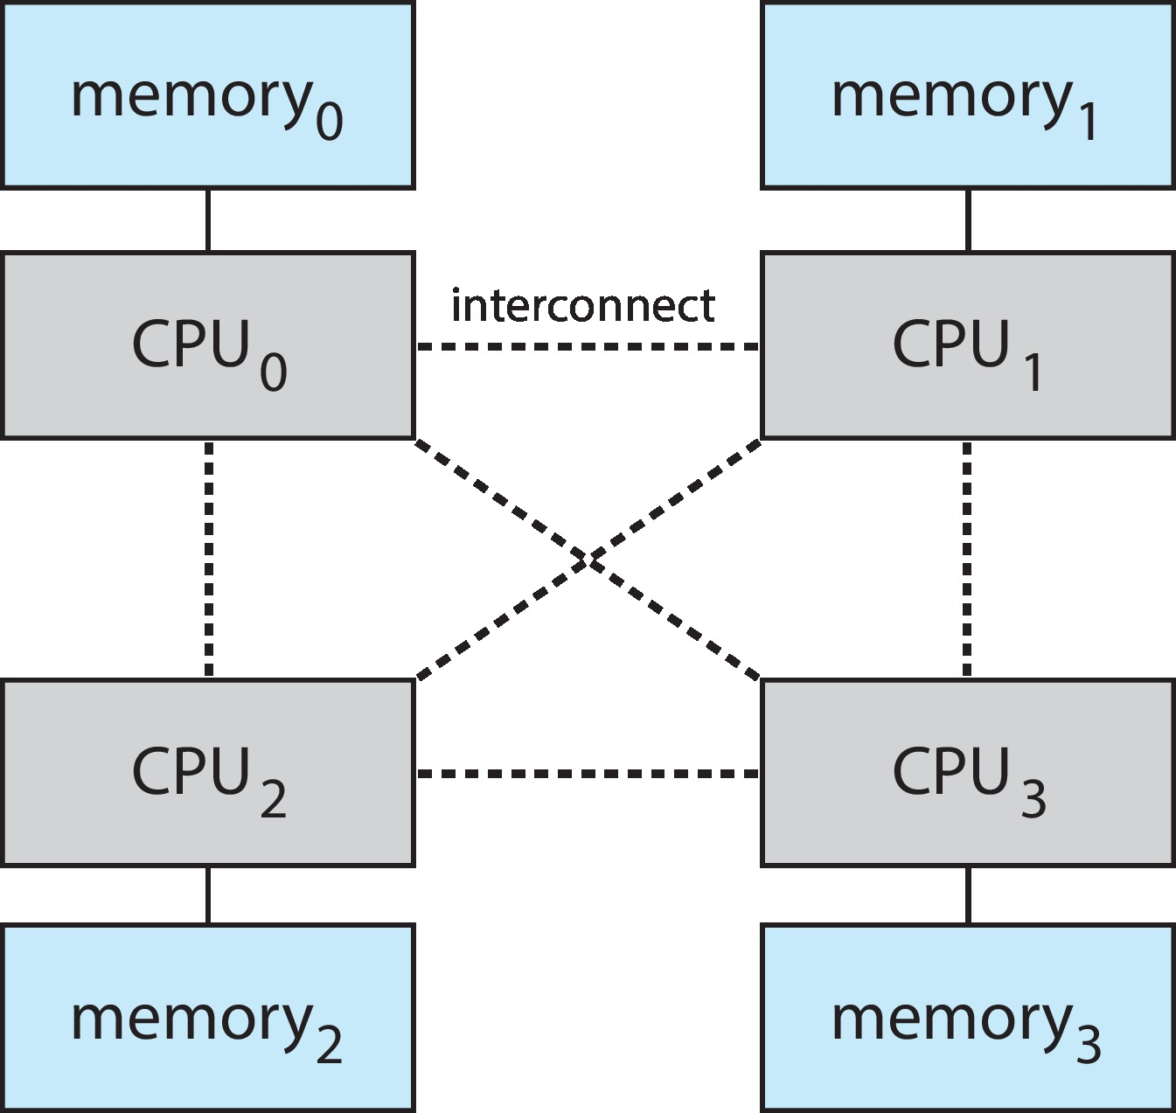
Non-Uniform Memory Access System
NUMA, is a method of configuring a cluster of microprocessors in a multiprocessing system so they can share memory locally.

Slide 44
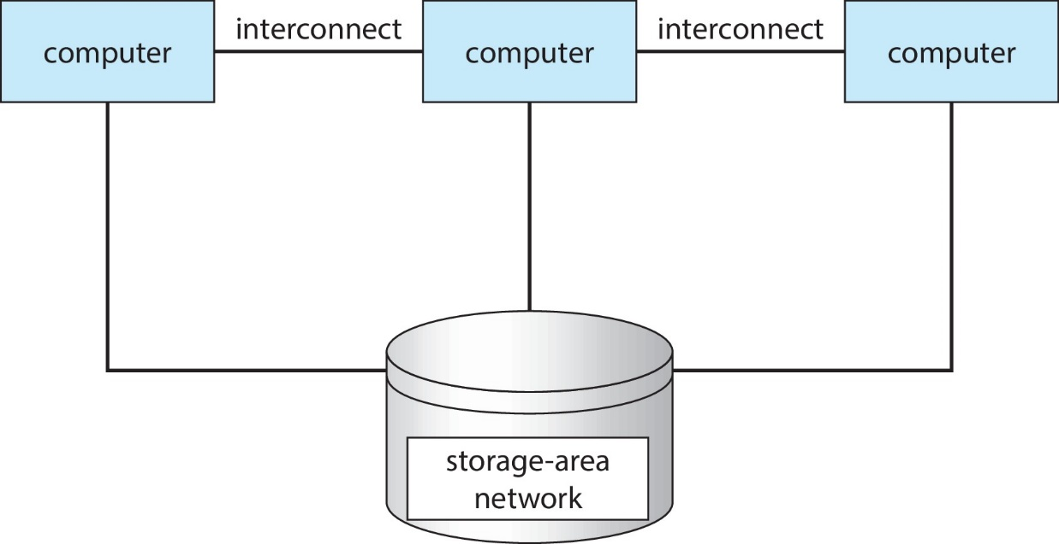
Clustered Systems
Clustered systems are created by two or more individual computer systems merged together. Basically, they have independent computer systems with a common storage and the systems work together.

Slide 45
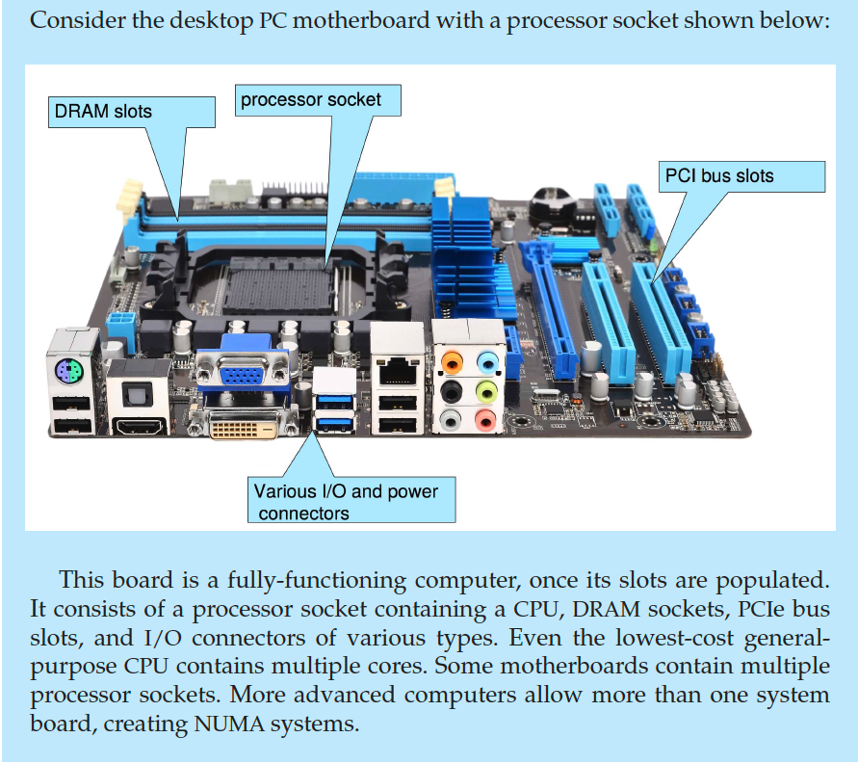
PC Motherboard

Slide 46
Operating-System Operations

Slide 47
Operating-System Operations
OS: Provides an environment to execute programs.
Bootstrap Program: Initializes system and loads OS kernel.
Daemons: Background processes that provide essential services.
Example: "systemd" on Linux starts and manages other daemons.
Run continuously to handle tasks like logging, scheduling, or networking.
OS waits for interrupts or events to activate daemons or processes.

Slide 48
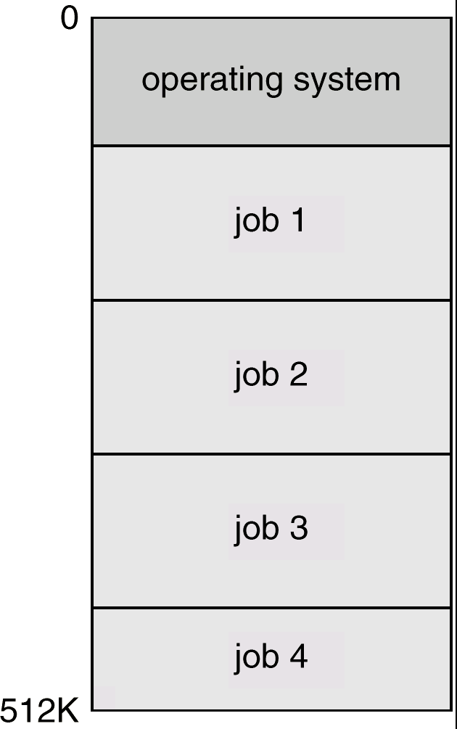
Multiprogrammed Systems
Several jobs are kept in main memory at the same time, and the CPU is multiplexed among them.
One job selected and run via job scheduling

Slide 49
Multitasking (Timesharing)
A logical extension of Batch systems– the CPU switches jobs so frequently that users can interact with each job while it is running, creating interactive computing
If several jobs ready to run at the same time  CPU scheduling

Slide 50
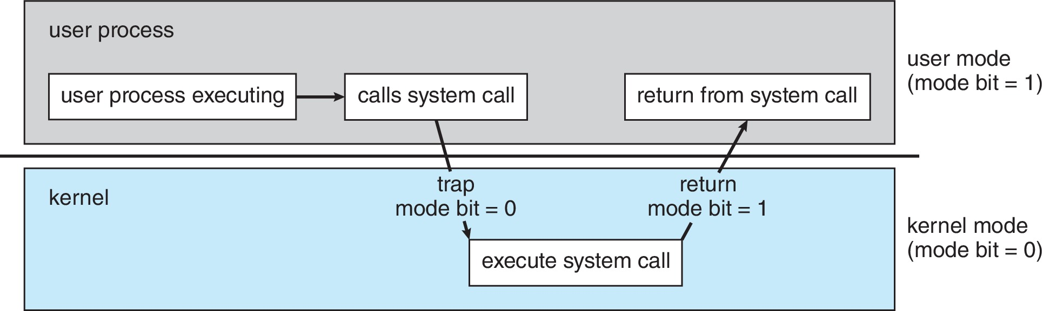
Dual-mode Operation
Dual-mode operation allows OS to protect itself and other system components
User mode and kernel mode
User Mode: Limited privileges (for user programs).
Kernel Mode: Full control (for OS tasks).
Transition: Occurs through interrupts, traps, or system calls.

